Slide 1
Industry Partners Marketing Toolkit
Utilize the resources in this toolkit to promote registration and your participation at this year's event. Encourage your professional network and colleagues to join us in Miami Beach, FL!

Slide 2
Introduction to the I.C.E. Exchange
We are excited to welcome you to the 2024 I.C.E. Exchange! We have created a variety of resources to help you promote your attendance and your booth at this year’s event in Miami Beach, FL. Browse this toolkit for sample copy you can use in email, your website, and within your social media networks.

Slide 3
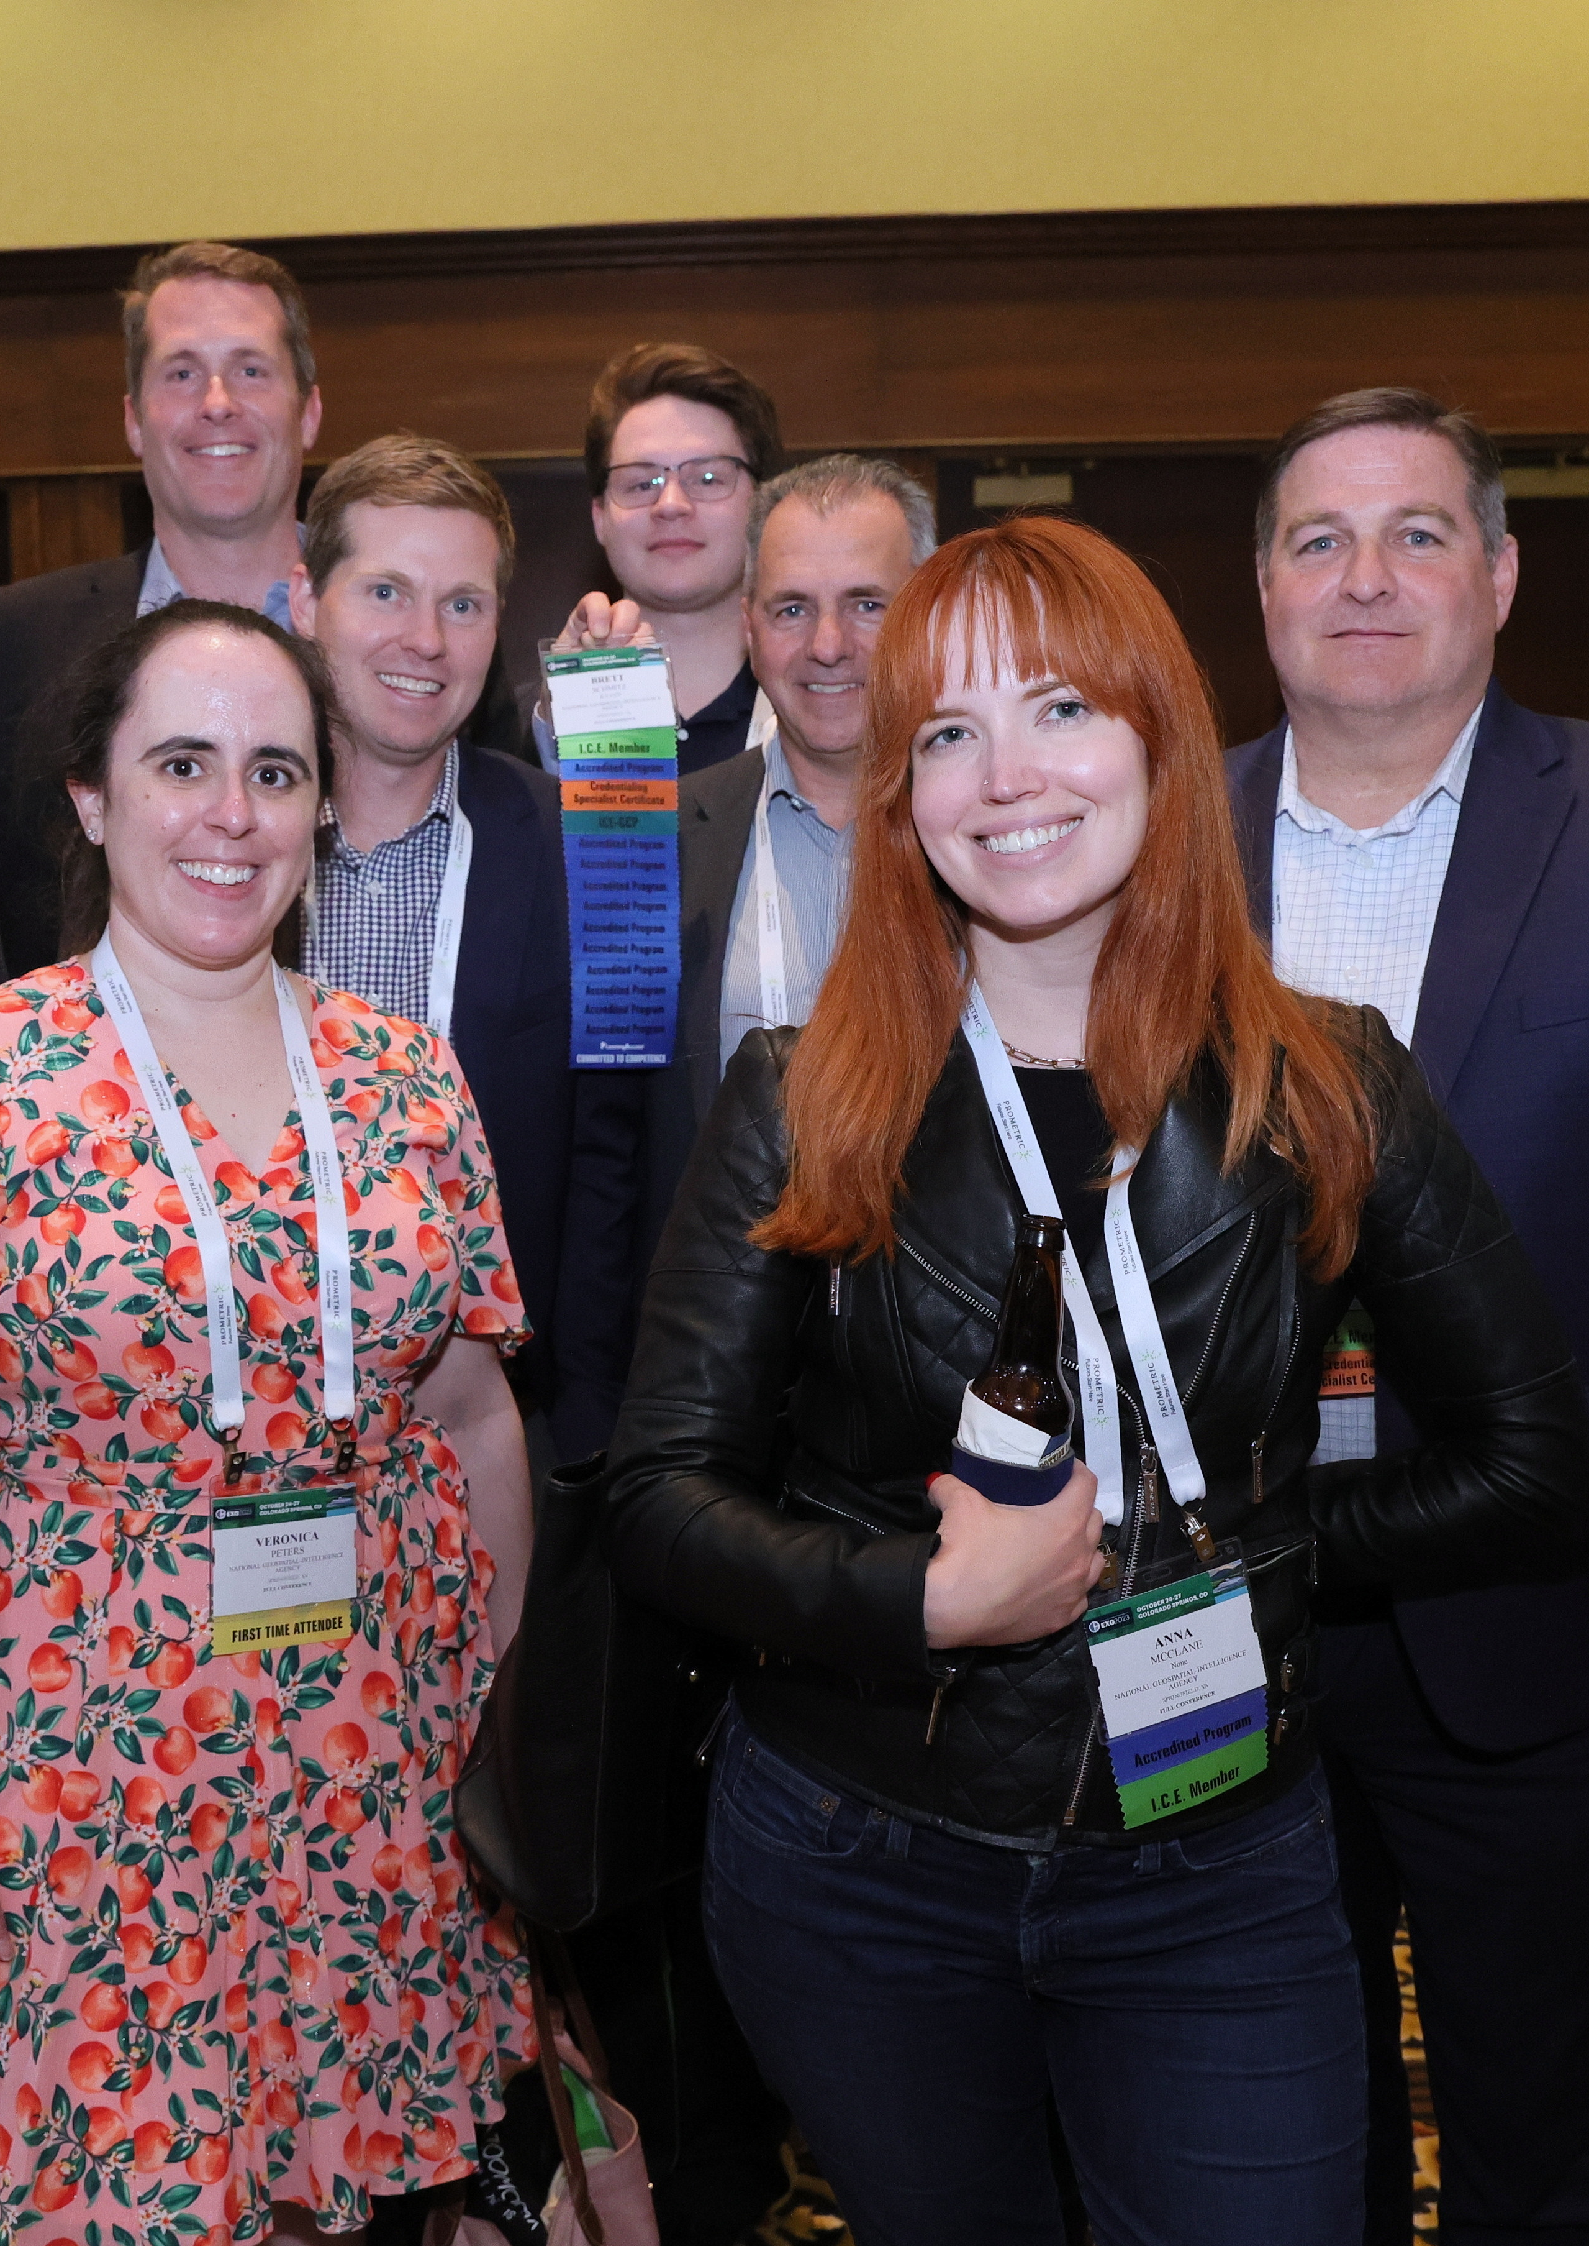
Website Content
Please use the below web content for the 2024 I.C.E. Exchange

Slide 4

Website Content
Web Banner
Add the following web banner to a high-profile page on your personal or company’s website, blog, and social media profiles.
Link the web banner to the I.C.E. Exchange website: www.ice-exchange.org

Slide 5
Website Content
Post the below event listing to your company’s website or calendar of events page. If you can’t use all of the copy below, use the event name, date, location, and URL.
I.C.E. Exchange 2024
November 17 – 20 | Miami Beach, Florida
www.ice-exchange.org
  Join credentialing professionals at the I.C.E. Exchange 2024 in Miami Beach, Florida, November 17 – 20. This premier annual conference brings together credentialing professionals from across industries and career stages to explore credentialing trends, share best practices, and foster valuable connections. Featuring keynote presentations, interactive workshops, and networking opportunities, the I.C.E. Exchange is the ideal platform to advance your knowledge and enhance your credentialing programs. Visit the I.C.E. website to view all programming and register for the event. We look forward to seeing you in Miami Beach!
For a more customized message, use the below listing:
We are pleased to announce that [Company Name] will be exhibiting at the I.C.E. Exchange 2024 in Miami Beach, Florida, from November 17 to 20. Meet me at [booth #] to discuss [offerings]. We look forward to welcoming you in Miami Beach.

Slide 6
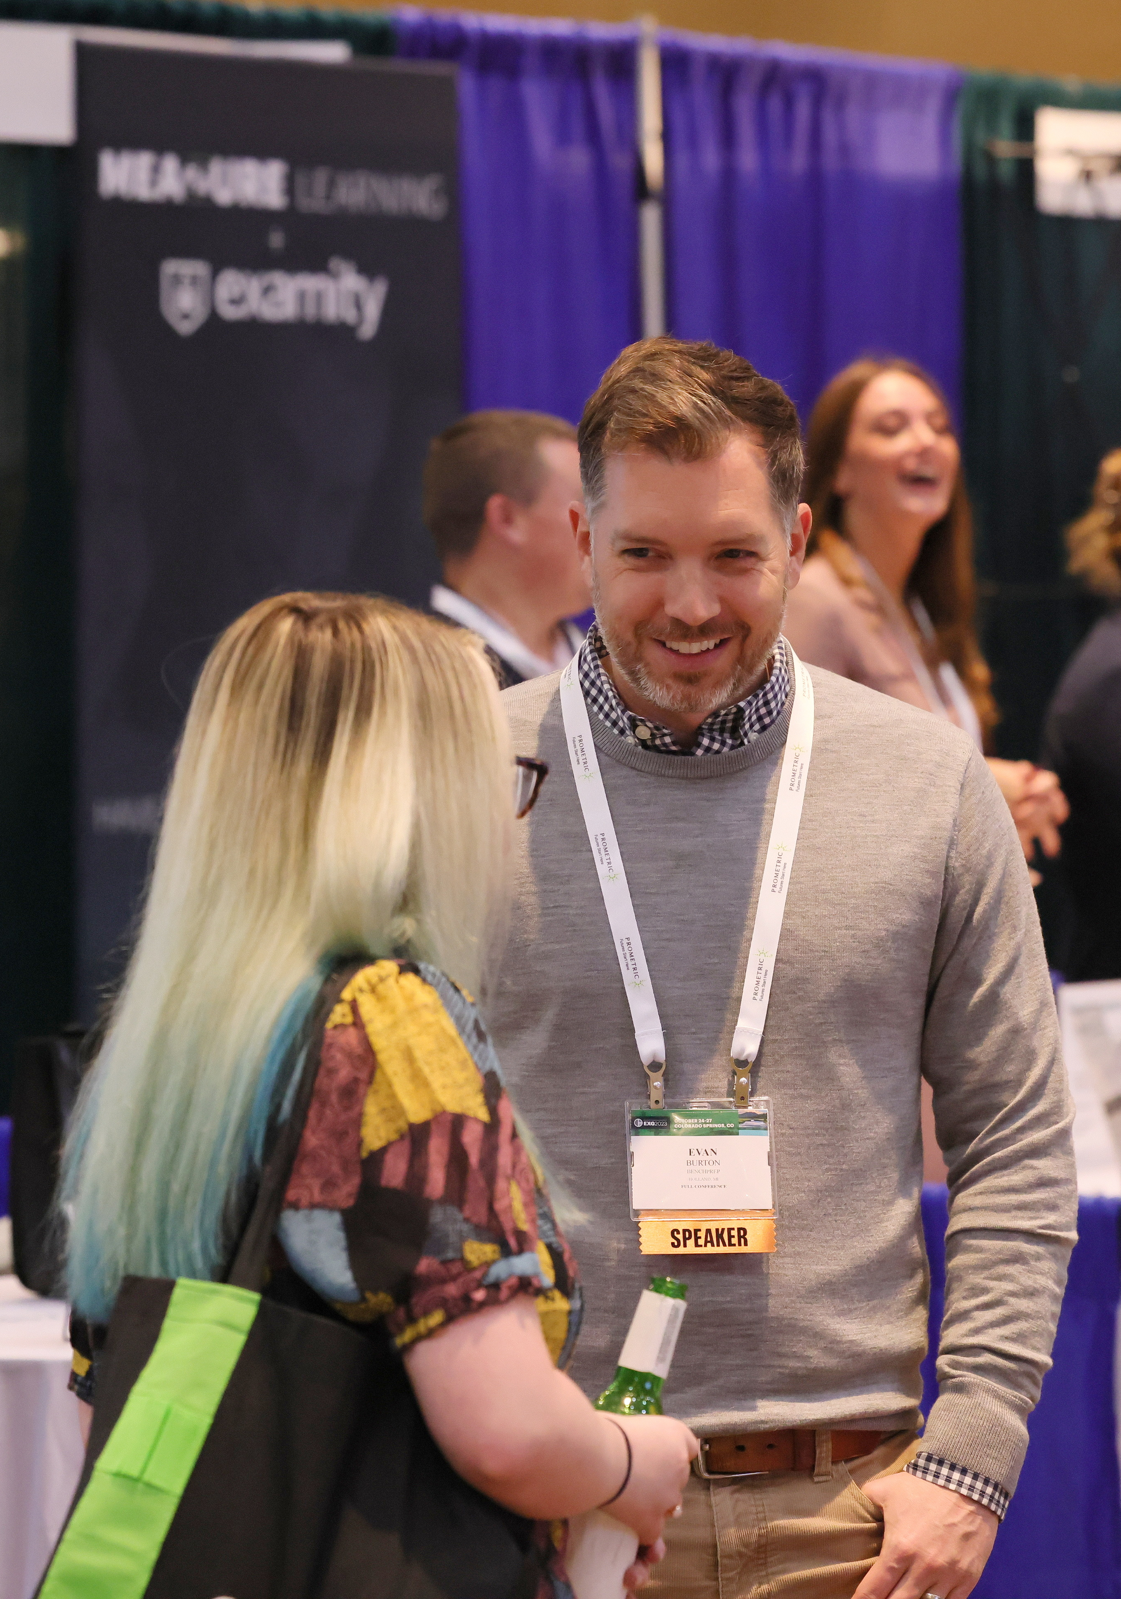
Promotional Email
Introduce your company and your expertise to encourage attendees to visit your booth.

Slide 7
Sample Email – Industry Partners
Subject: Visit [Company Name] at the 2024 I.C.E. Exchange
Body: Dear [Name],
Join [Company Name] at the I.C.E. Exchange hosted by the Institute for Credentialing Excellence (I.C.E.) November 17-20, 2024 in Miami Beach, FL. This premier event for credentialing professionals offers unparalleled education, networking, and resources.
In addition to the structured educational program, you can meet with me and learn more about our offerings during social events and dedicated Innovation Hall hours. Stop by booth [booth number] to learn more about [offering] or schedule a meeting.
[Two or three offerings or products that you would like to highlight]
Visit the I.C.E Exchange website to register. I look forward to seeing you at Miami Beach, FL.
Sincerely, [Signature]

Slide 8
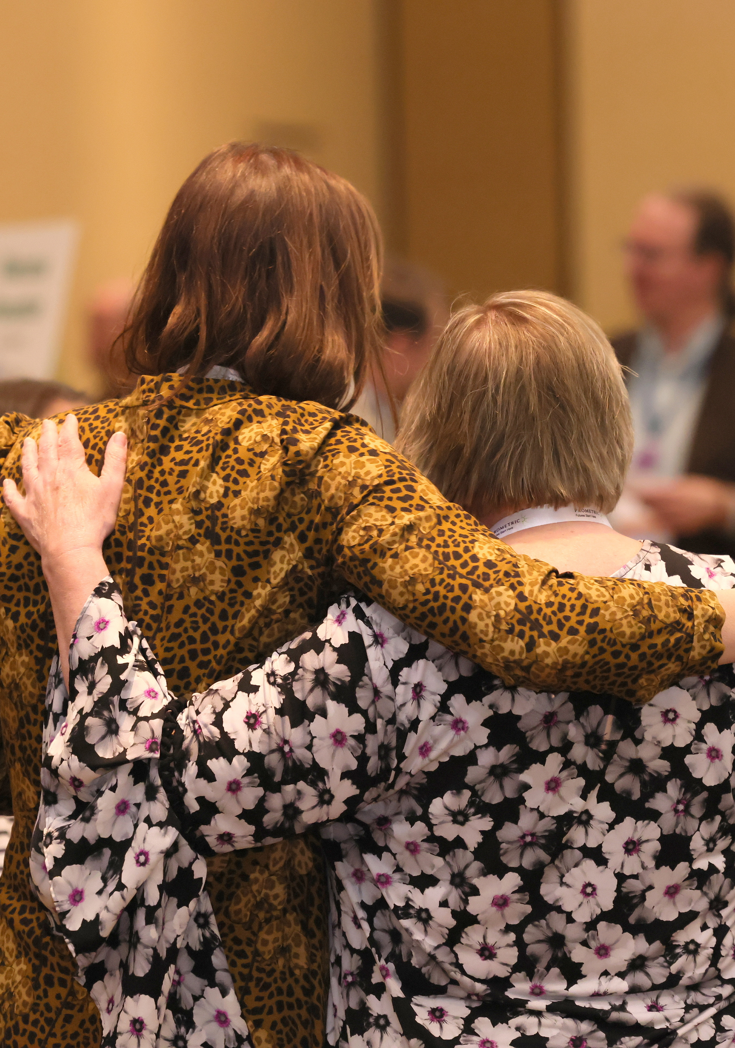
Social Media
Use social media to help us promote the 2024 I.C.E. Exchange on your personal social media channels.
Use #EXG2024 and tag us on LinkedIn so we can interact with your posts!

Slide 9
Sample Social Media Posts
Curious to learn about [topic]? Join me at booth [booth number] to learn more at #EXG2024! https://www.ice-exchange.org/Registration
[Company Name] is exhibiting at the I.C.E. Exchange in Miami Beach, FL on November 17-20. Register for the 2024 Exchange to join me at [booth] and learn more about our offerings. I look forward to seeing you in Miami Beach! https://www.ice-exchange.org/Registration
Countdown to #EXG2024! Save the date for my booth [booth number] on [Date], where I'll discuss [Topic]. Let's connect in Miami Beach! Register now: https://www.ice-exchange.org/Registration
  Utilize these social media posts to increase excitement around the Exchange.
  Don't forget to include an image and use the event hashtag #EXG2024.

Slide 10


Social Media Graphics
LinkedIn Graphic
LinkedIn Header

Slide 11
Social Media Dos & Don'ts
In LinkedIn's professional setting, concise posts are more effective, emphasizing clarity and brevity.
Tag I.C.E. for enhanced engagement. @Institute for Credentialing Excellence in your posts to broaden visibility.
Incorporate hashtags such as #EXG2024 to connect with professionals interested in the event.
Post during peak LinkedIn activity hours, typically mid-morning (around 9 AM to 11 AM) and early afternoon (1 PM to 3 PM), to maximize visibility and engagement.
Share registration links to I.C.E. events or resources to effectively guide interested audiences: https://www.ice-exchange.org/Registration

Slide 12
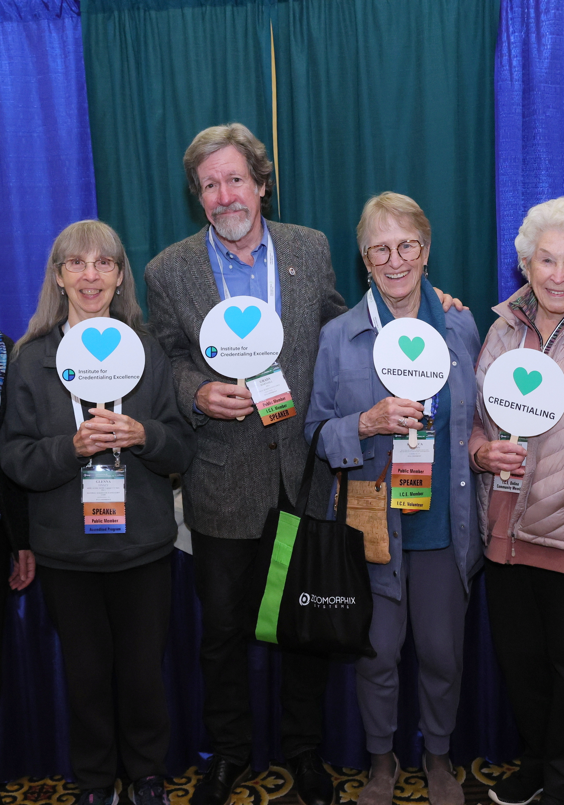
Record a Promotional Video
Spread the word about your company in a video message.

Slide 13
Spread a Video
Record a video encouraging people to stop by your booth.
Click the link below to share a brief video message about your company. Your video will be automatically sent to I.C.E. for promotional use!
In 140 seconds or less, introduce your company, share what people can expect in your booth or from your company, and invite attendees to visit your booth.
Record Your Video Message Here

Slide 14
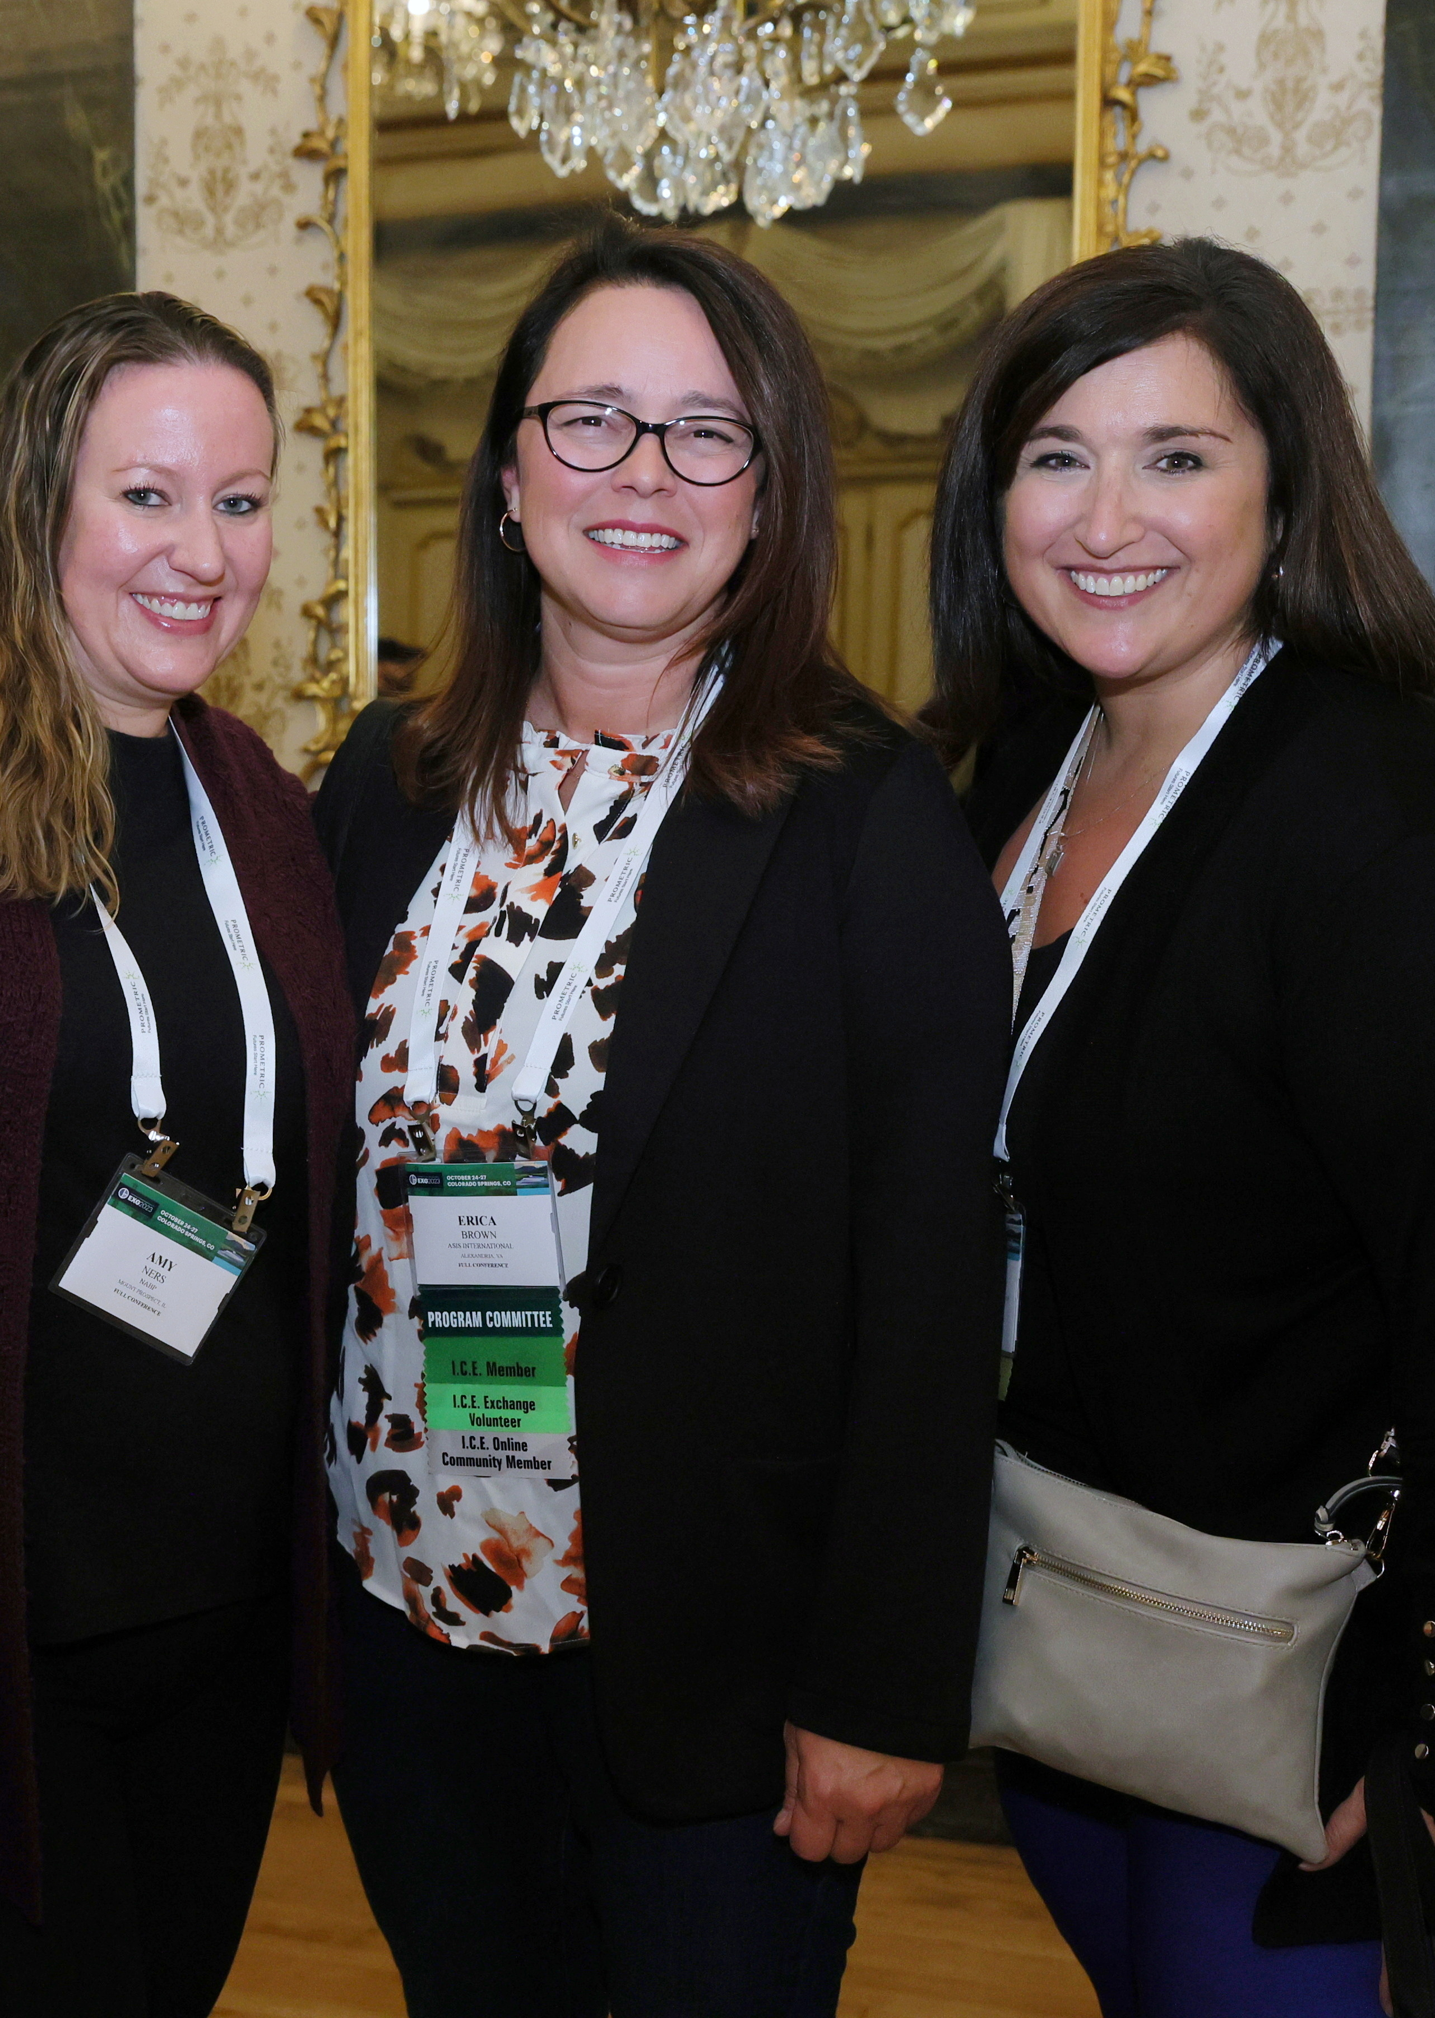
Share the Value of I.C.E.
Earn points towards booth selection for the 2025 I.C.E. Exchange by referring potential members to I.C.E.

Slide 15
Industry Partner Referral Program
I.C.E. recognizes Sustaining and Affiliate members who refer new members.
For each referral who joins I.C.E., the Sustaining/Affiliate member will earn points to be used in the booth selection process for the following years' I.C.E. Exchange (so those recruited in 2024 will earn points for 2025). Points will be tabulated and reported out by I.C.E. staff by the deadline of February 20, 2025.
Learn more about the referral program.

