Slide 1

Clinical Case – Maturation Failure
Belo Horizonte, Brazil and NY, USA
Dr. Nicos Labropoulos
Dr. Adriano José de Souza
Dr. Guilherme de Castro-Santos

Slide 2
Maturation Failure
Male patient 72 years old
Pre-dialysis due to diabetic nephropathy
CrCl 20ml/min
Interventions
Snuff box radiocephalic fistula 2023
Medications
Atenolol, Losartan, Amlodipine

Slide 3
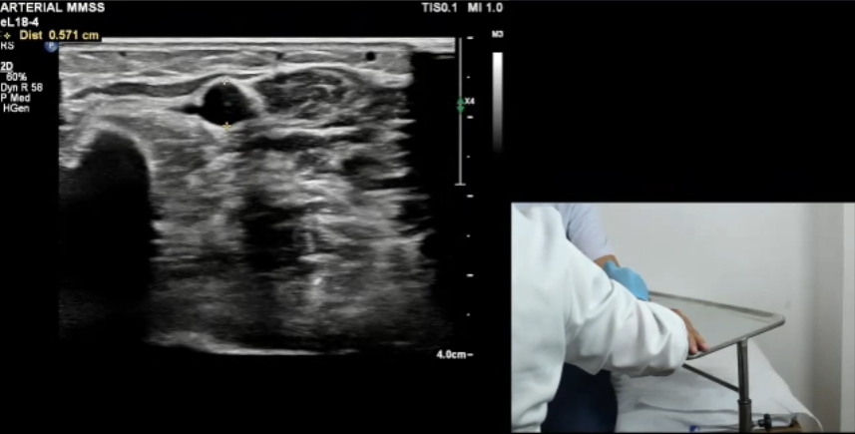
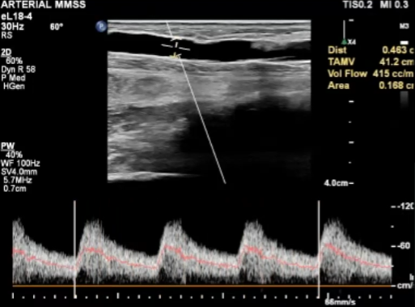
Flow volume measurement
The radial artery proximal to anastomosis is enlarged
due to flow-mediated dilatation.
Flow volume is measured in the inflow artery (here is the radial)
at least 3cm above the anastomosis.
The sample volume matches the inner artery diameter to include
all the velocities in the entire lumen. The artery is image in the
B-mode to allow precise measurement of its diameter.
The Doppler waveforms occupy at least 2/3 of the screen and the
Doppler gain is reduced with the background appearing black.
The time average mean velocity is measured over at least
3 cardiac cycles.
The volume flow here was 415ml/min showing maturation failure.
RA 5.7mm

Slide 4
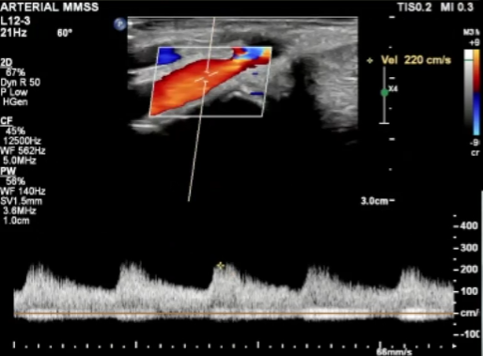
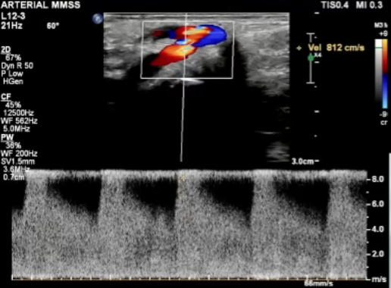
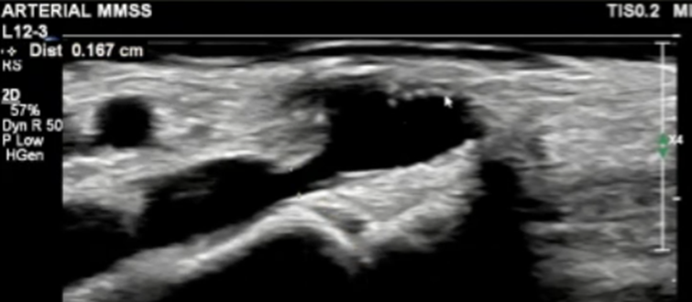
Evaluation of the radial artery
Focal juxta anastomotic stenosis of the radial artery
V1= 220cm/s
V2= >800cm/s
V2/V1= 4
Significant stenosis
Luminal diameter at stenosis 1.7mm
Proximal artery diameter 5.7mm

Slide 5
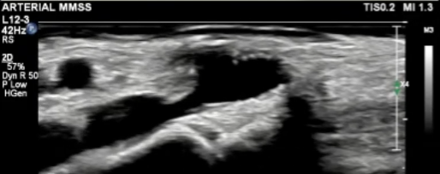
Evaluation of the radial artery
Focal juxta anastomotic stenosis of the radial artery
Suture line
RA stenosis

Slide 6
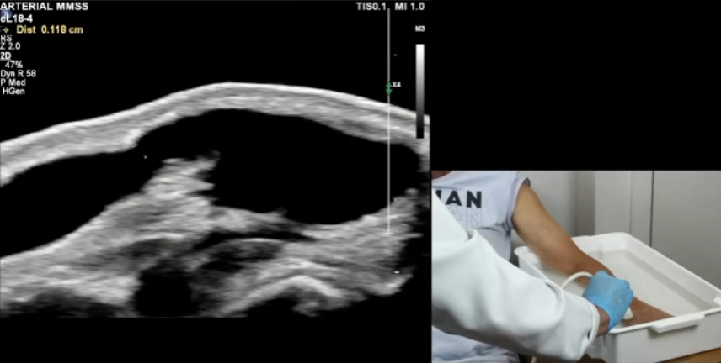
Fistula evaluation using water bath
Evaluation of very superficial fistula can also be done using non contact techique. It is a great method to visualize in detail the dialysis access. It is also an excellent way to perform vein mapping prior to dialysis access creation in patients with suboptimal veins. In these patients the water should be warm (44 degrees C) to allow vasodilation.
Water
Skin
Anastomosis
Cephalic vein
Stenosis
Van Bemmelen PS, et al. Improvement in the visualization of superficial arm veins being evaluated for access and bypass. J Vasc Surg. 2005;42:957-62.

Slide 7
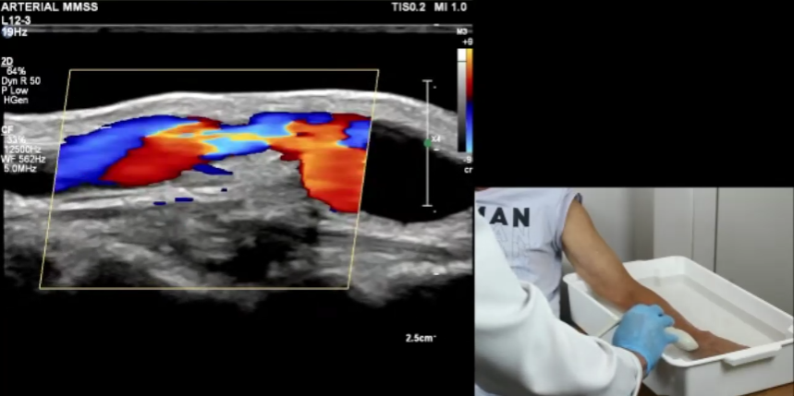
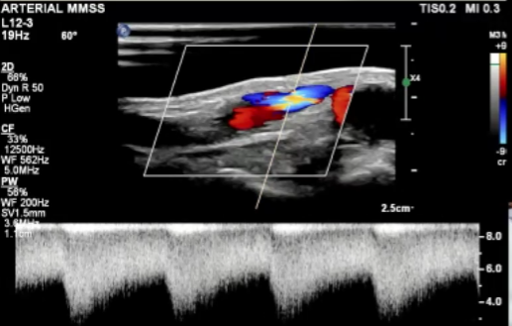
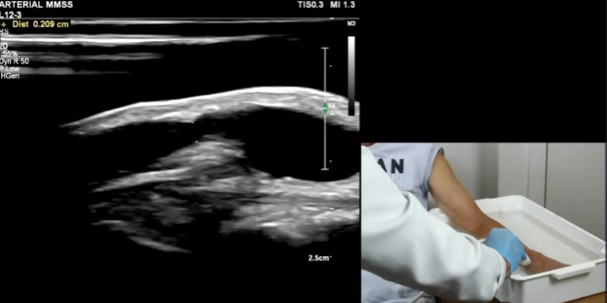
Evaluation of the cephalic vein
Focal juxta anastomotic stenosis of the cephalic vein
Aliasing and high velocities are seen in the cephalic vein just after the anastomosis. The lumen at the stenosis is 2.1mm and proximal is 6mm.
At stenosis CV 2.1mm
Proximal CV 6mm

Slide 8
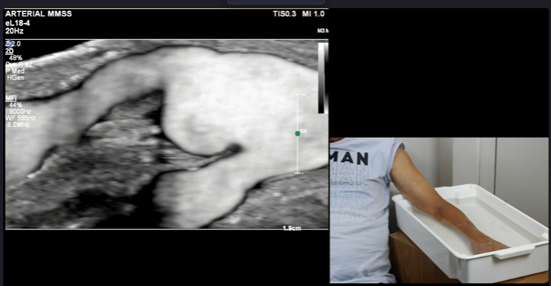
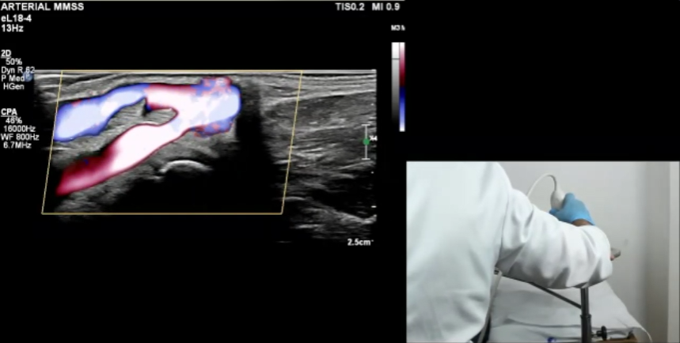
Access evaluation
Use of directional and non-directional power Doppler to evaluate the access.
Using power Doppler, the contour of the vessels and the blood wall Interface is clearly seen. As power Doppler is almost angle independent views like the angiogram are seen.
Here it is clearly seen that the anastomosis is fine but there is
Focal juxta-anastomotic stenosis in both the radial artery and cephalic vein.

Slide 9

CiDA 2025
October 30 – November 1 | Boston, MA
dialysiscontroversies.org
The Controversies in Dialysis Access (CiDA) Symposium is the leading educational forum for surgeons, radiologists, nephrologists and medical staff who care for dialysis access patients.
The patient presented in this clinical case will be discussed at CiDA.
Come to CiDA to learn of how to evaluate and treat dialysis access patients
having different types of pathology, analyze and discuss many controversies and
also see the current innovations and clinical trials in the field.

