Slide 1
Case Title
SLIDE 1: This slide should include the title of case, speaker name(s) and affiliate institution(s).
No commercial logos are allowed on this or any other slide.
First Name Last Name Institution

Slide 2
Slide 2: Disclosure Template
I have the following relevant financial relationship(s) to disclose: Shareholder: YYY Corporation, Officer or Board Member: XXX, Grant/Research Support: ZZZ.
-OR-
I have no relevant financial relationship(s) with ineligible companies to disclose.
All of the relevant financial relationships listed for these individuals have been mitigated.

Slide 3
Slide 3: Introduction
Briefly introduce your case, but do not include the final diagnosis.

Slide 4
Slide 4-7: Case Presentation
Present data about the patient. Information may include:
Description of why the patient sought medical help.
Observations of medical exam.
Description and results of any specialized tests that were performed.

Slide 5
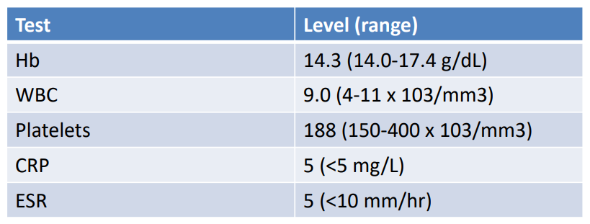
Slide 8: Case Investigation/Data
Include any test result data.

Slide 6
Slide 9: Audience Response Slide
Prepare one multiple choice question for your case, limited to 3-5 answer choices, no more than 100 characters in length for questions and answers.
This question will be posed to the audience for live voting on the meeting website. Do not put any extra information on this slide.
Example questions:
What would you do next?
What is the diagnosis?
Which of the following features helps distinguish the most likely cause of this patient’s symptoms?

Slide 7
Slide 10: Summary Slide
Report the final patient diagnosis, long-term outcome and any future research plans.
Summarize the lessons learned from the case and why they are significant for future treatments of similar cases.
Take Home Message: outline the primary educational points of your case study/diagnosis.

Slide 8
Slide 11: Evidence-Based Medicine (EBM) or Key References
Should only contain key references

Slide 9
Additional Formatting and Presentation Guidelines
Presentations should be set to Widescreen (16:9).
When including images, make sure they are high quality and very clear.
Text fonts should not be less than 18 pts. A well-sized font is between 22-24 pts.
Keep your words to a minimum. Each presenter is allotted exactly 10 minutes to present (including the ARS poll question and audience response time). Presenters should quickly run through title, disclosure and reference slides and plan less than 1 minute on each remaining slide. Presenters will NOT be allowed to exceed the allotted time.
Use only U.S. standard measurement units.

Slide 10
Additional Formatting and Presentation Guidelines
Cases should be presented as an unknown with the final diagnosis being identified near the end of the presentation.
Product/brand names and logos should NOT be included in the presentation body. However institution logos (ex. Non-PhRMA related logos such as school names, associations and government agencies) are allowed in the body of the presentation.
Company/product brand names should NOT be referenced during the presentation. Only scientific or generic names should be used. However, if it is necessary to reference a commonly use brand name or product, the scientific or generic name should be referenced next to it.
Example: Acetaminophen (Tylenol)

